Slide 1
Capturing the Power of Waves
Sandia Interactive Wave Energy Education Display
Sandia National Laboratories Water Power Technologies Department

Slide 2
A Brief History of Sandia National Labs

Slide 3
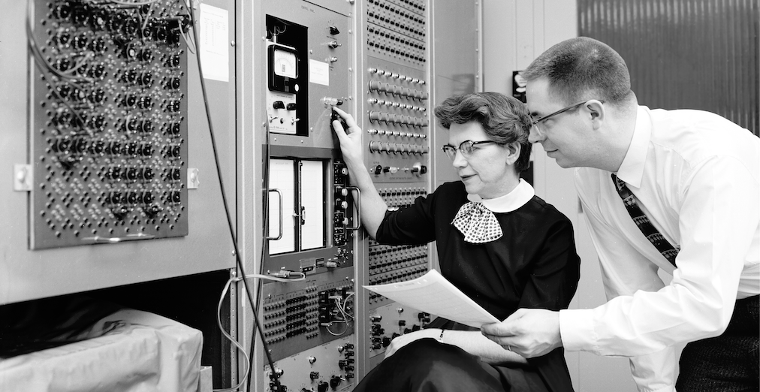
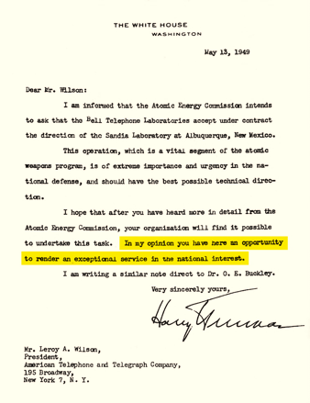
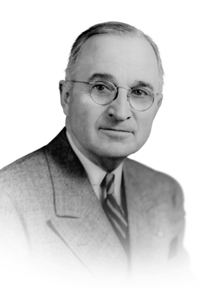
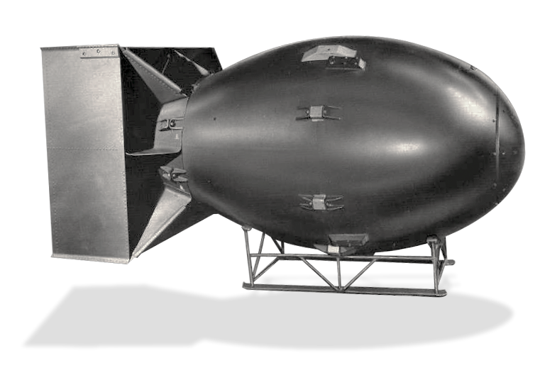

SANDIA’S HISTORY IS TRACED TO THE MANHATTAN PROJECT
July 1945: Los Alamos creates Z Division
Nonnuclear component engineering
November 1, 1949: Sandia Laboratory established
AT&T: 1949–1993
Martin Marietta: 1993–1995
Lockheed Martin: 1995–2017
Honeywell: 2017–present

Slide 4
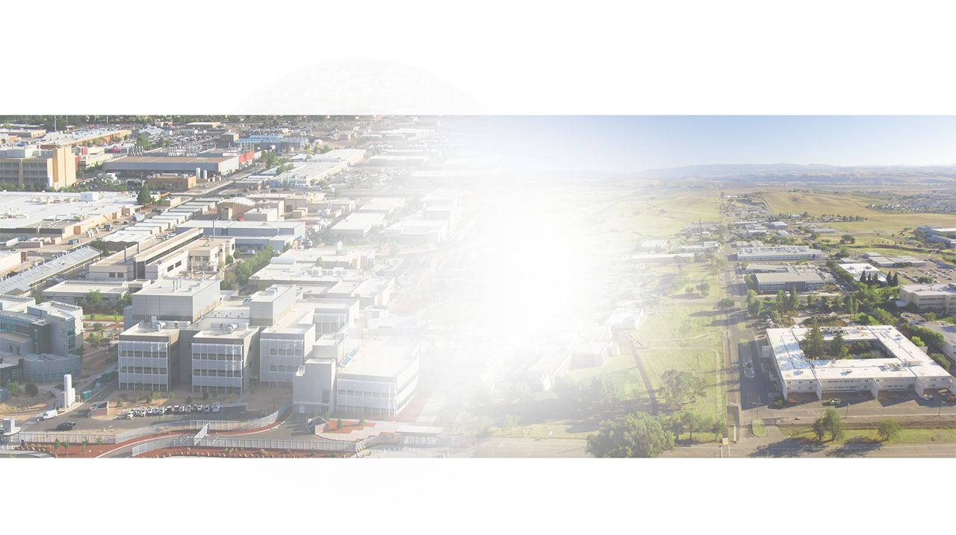
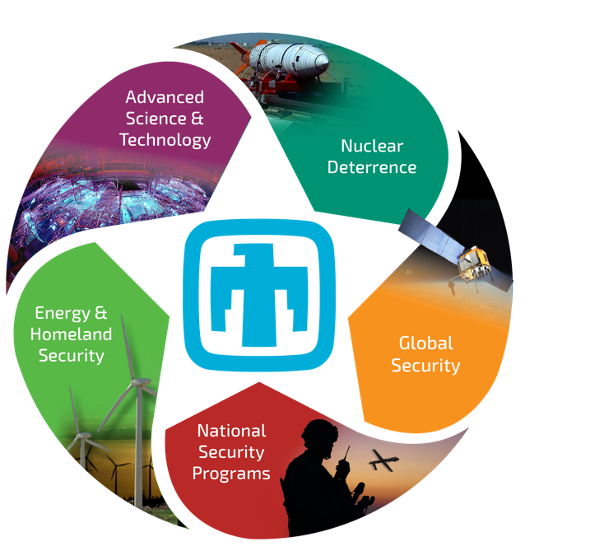
SANDIA HAS FIVE MAJOR PROGRAM PORTFOLIOS

Slide 5
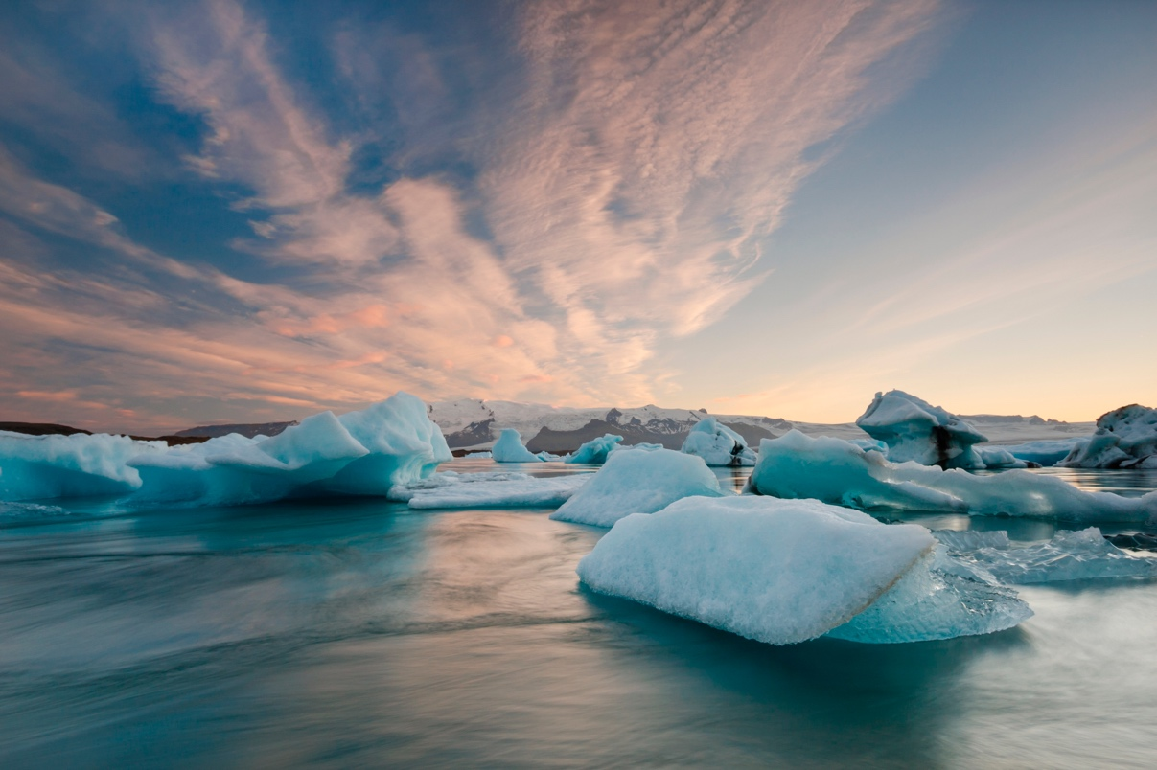


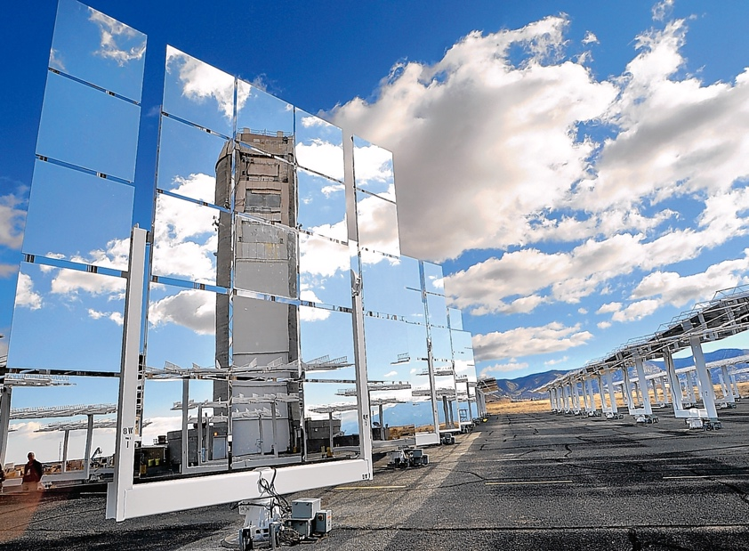
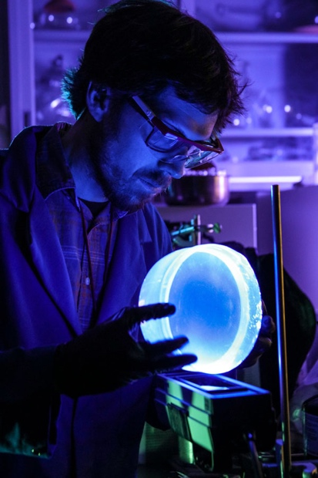
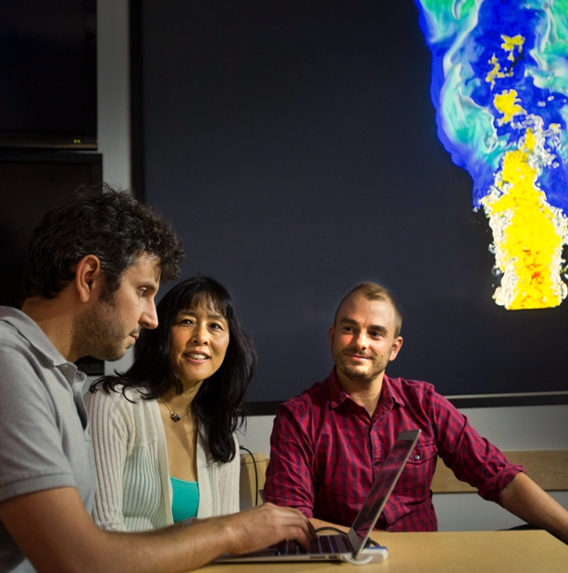
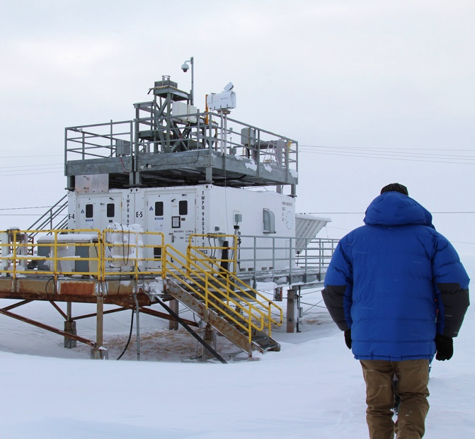
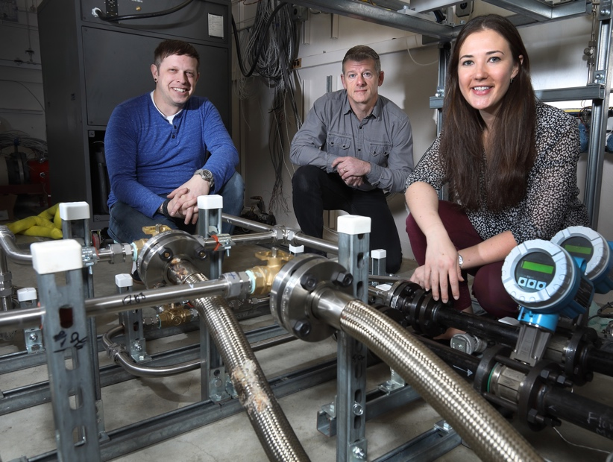
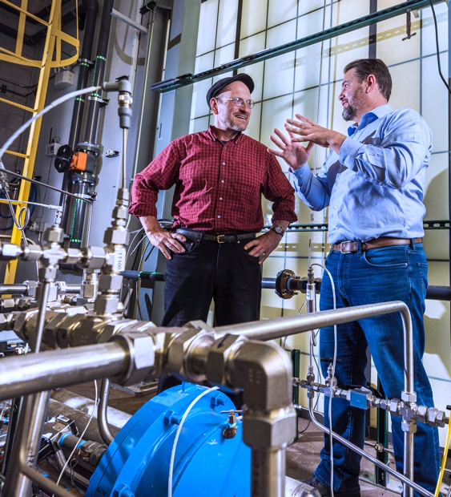
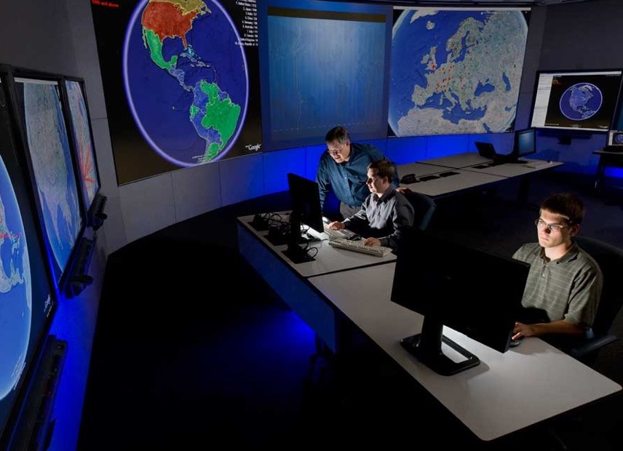
ENERGY & HOMELAND SECURITY
Secures the nation’s critical infrastructures and environment against attacks, threats, and climate change by performing world-class research and development.
Advance energy technologies and solutions to climate change
Create solutions for a safe, secure, and resilient energy future
Provide transformative solutions in the transportation sector
Reduce the nation’s vulnerability to chemical, biological, radiological, and nuclear threats
Provide protection for our nation’s digital and physical critical infrastructures
Notes:
The Energy and Homeland Security Portfolio secures the nation’s critical infrastructures and environment against attacks, threats, and climate change by performing world-class research and development.
The Energy & Homeland Security Portfolio Mission is made up of five program areas:
Renewable and Fossil Energy
Nuclear Fuel Cycle and Grid Modernization
Transportation Energy & Systems (TES)
Chemical, Biological, Radiological and Nuclear Defense (CBRN Defense)
Homeland Infrastructure Security & Resilience (HISR)
Energy
Renewable and Fossil Energy Program area will include Renewable Energy Technologies and Geoscience Research & Application.
The Nuclear Fuel Cycle and Grid Modernization Program Area creates solutions for a safe, secure, and resilient energy future. Programs: Nuclear Energy Safety & Security, Nuclear Energy Fuel Cycle, Grid Modernization & Energy Storage, Energy Efficiency, and DOE-managed Nuclear Waste.
The Transportation Energy & Systems Program Area provides transformative solutions in the transportation sector. Programs: Vehicle Technologies, Biomass Technology, Hydrogen & Fuel Cells, and ARPA-E.
Homeland Security
The CBRN Defense Program Area reduces the nation’s vulnerability to chemical, biological, radiological, and nuclear threats. Programs: Department of Homeland Security CBRN Defense, Health & Human Services CBRN Defense, and Chem Demilitarization & Industry Partnerships.
The Homeland Infrastructure Security & Resilience Program Area provides protection for our nation’s digital and physical critical infrastructures. Programs: Cybersecurity & Critical Infrastructure Security, and Threats, Security, & Resilience.

Slide 6
Water Power at Sandia National Labs

Slide 7
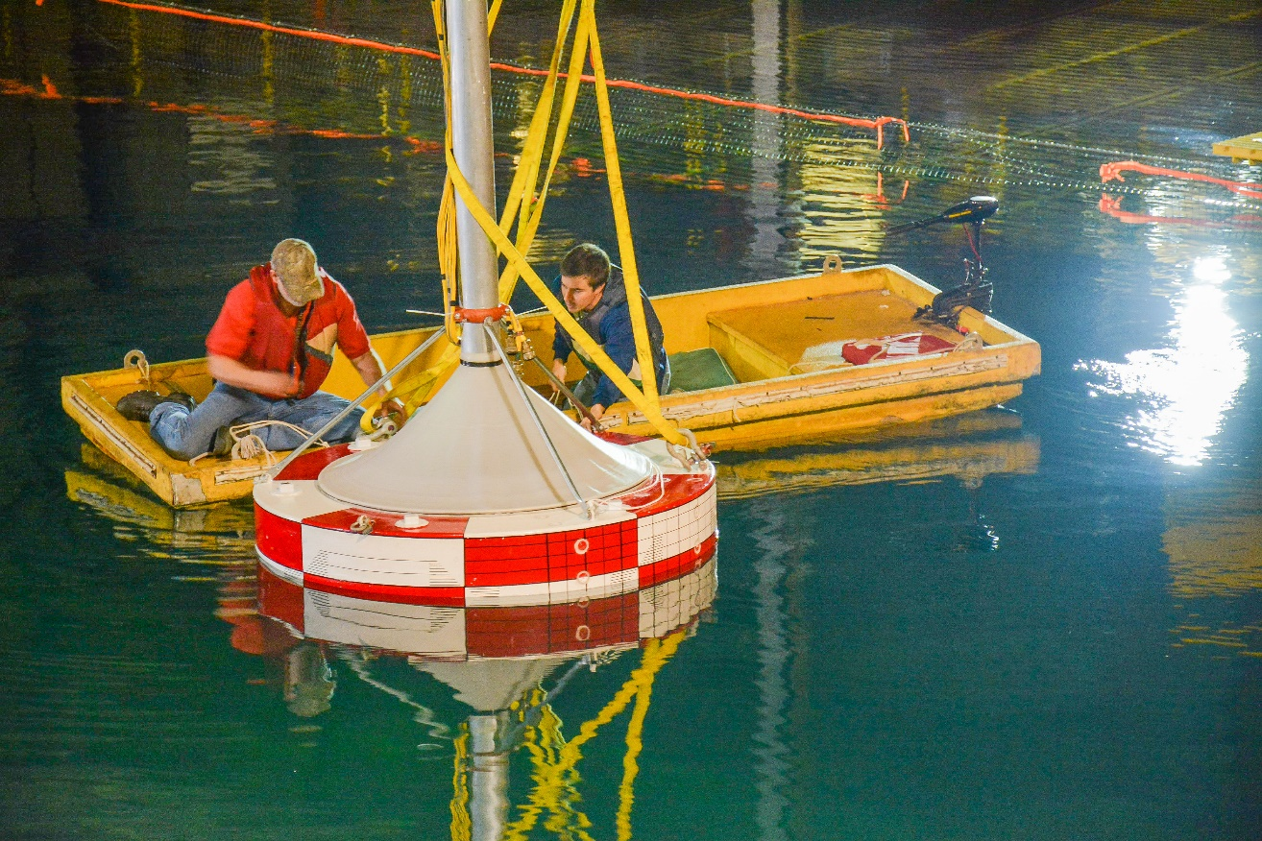
Water Power at Sandia
Sandia’s Water Power Technologies Department focuses on the energy we can get from the ocean, known as Marine Hydrokinetic Energy (MHK)
Leverages key research and engineering capabilities in support of the growing Marine Hydrokinetic industry.

Slide 8
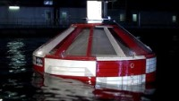
Water Power at Sandia

Slide 9
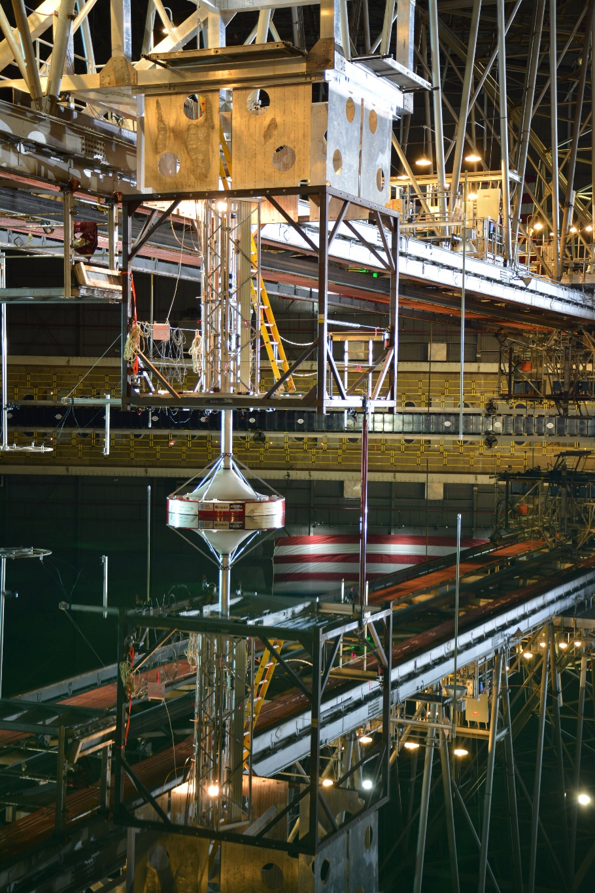
Water Power at Sandia
One important research area at Sandia’s Water Power Technologies Office is Advanced Wave Energy Converter Dynamics and Controls
Sandia is researching how to maximize the power produced by waver energy converters by changing how wave energy converters respond to waves.

Slide 10
What is Marine Hydrokinetic Energy?

Slide 11
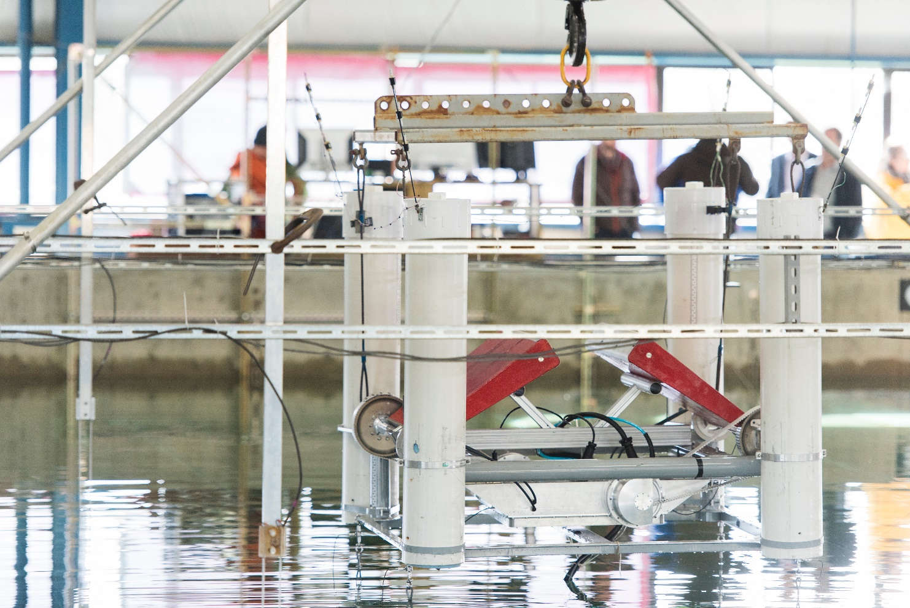

What is Marine Hydrokinetic Energy?
Marine Hydrokinetic Energy (MHK), converts the motion of the ocean into electricity that you and I can use!
Imagine being able to turn on a TV powered by the sea!

Slide 12
Types of Marine Hydrokinetic Energy

Slide 13
Types of Marine Energy
We can harvest energy from the ocean in a variety of ways based on the different ways the ocean moves.
Waves
Tides
Currents
There are different marine energy devices that can generate energy from each of these types of ocean movement.

Slide 14
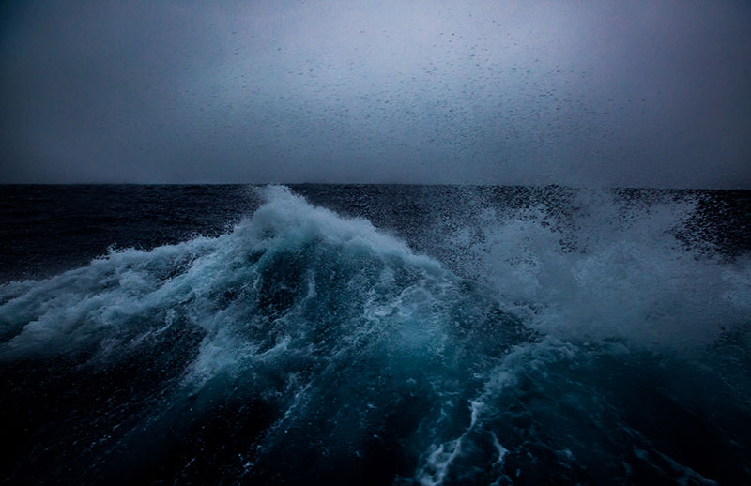
Waves
Waves are what you see crashing on the beach
Waves occur at the surface of the water.
Wave Energy Converters (WECS) are used to capture their energy
https://oceanexplorer.noaa.gov/facts/waves.html

Slide 15
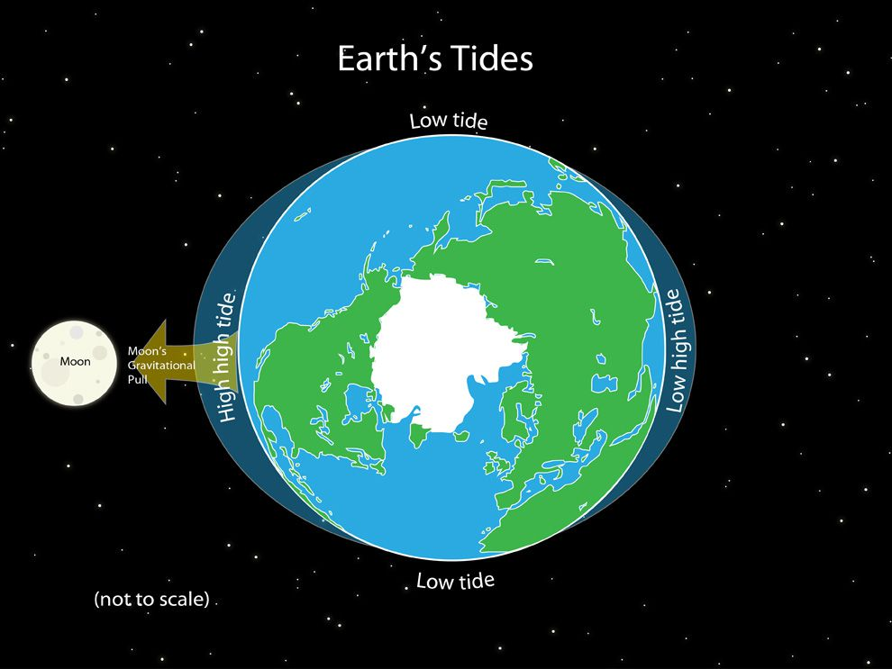
Tides
Tides are the rise and fall of the ocean due to the gravitational pull of the moon.
Many different devices convert the energy of tides into electricity
https://www.nationalgeographic.org/media/earths-tides/

Slide 16
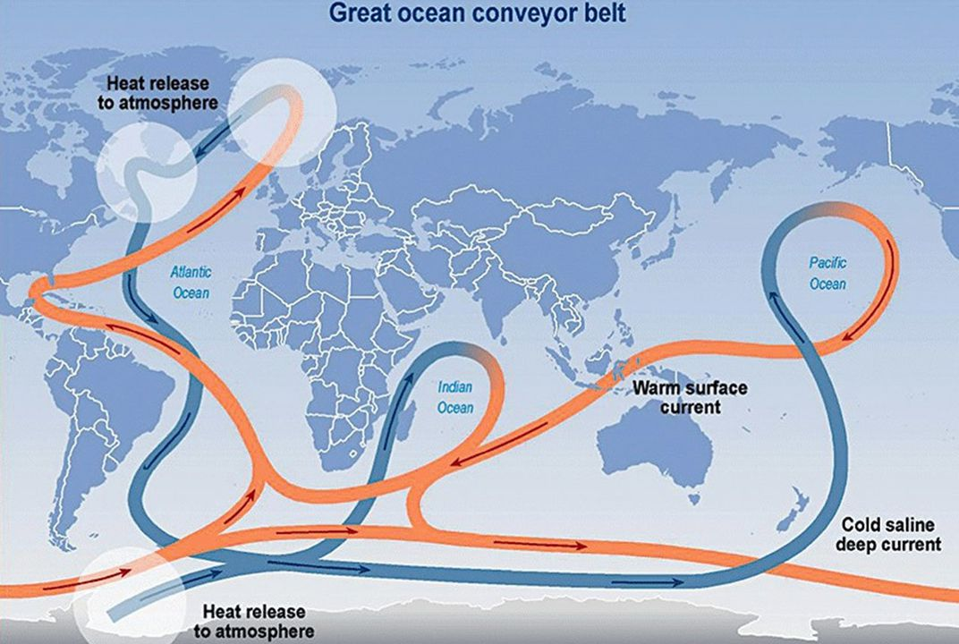
Currents
Currents are the general movement of the water.
They are impacted by tides, waves, and the temperature of the water.
It is like a river in the ocean
https://www.smithsonianmag.com/smart-news/ocean-current-keeps-europe-warm-weakening-180968784/

Slide 17
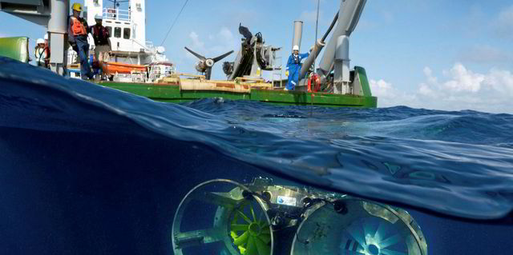
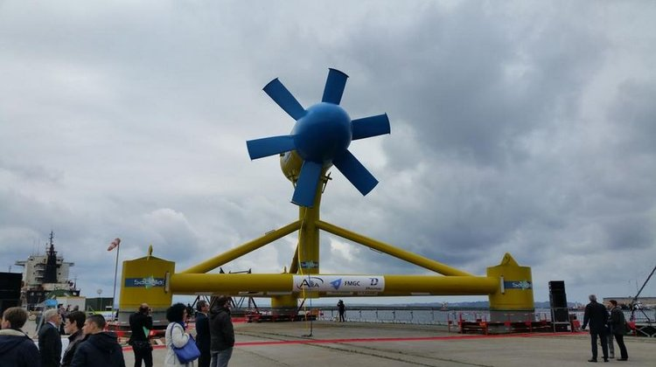
Current and Tidal Energy Devices
https://www.rechargenews.com/transition/first-gulf-stream-ocean-current-energy-farm-by-next-year-after-florida-tests/2-1-819094
http://www.openocean.fr/en/news/2015/05/20/open-ocean-team-greeted-at-the-naming-ceremony-of-the-sabella-d10-tidal-turbine/

Slide 18
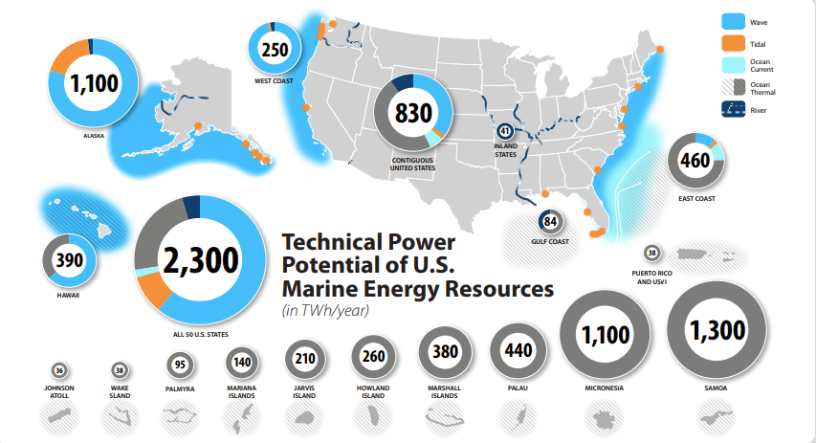
Marine Energy Resources

Slide 19
Wave Energy Converters

Slide 20
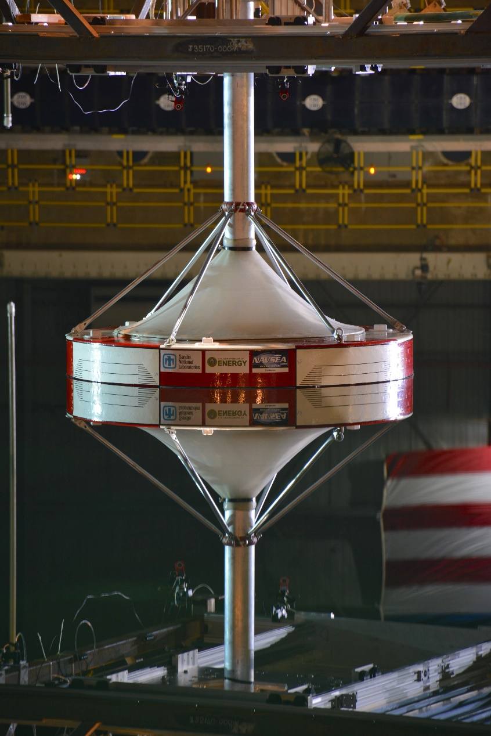
Wave Energy Converters
Today we will be demonstrating a Wave Energy Converter (WEC)
WECs convert the waves of the ocean into electricity.
WECs move up and down with the motion of the waves
As it moves up and down it spins a generator that converts the energy from the ocean waves into electricity.

Slide 21
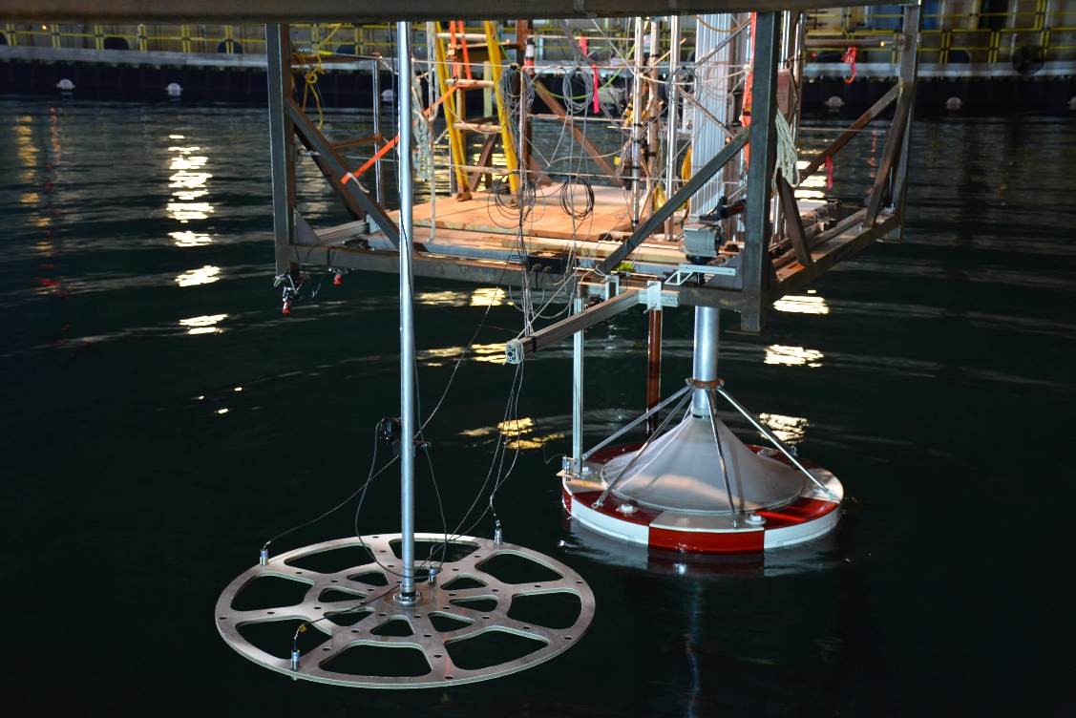
Wave Energy Converters
The amount of power produced by the WEC is dependent on:
The size and shape of the waves.
How the WEC responds to the waves.
Humans can’t control the waves in the ocean, so to generate more electricity from WECs Sandia is researching how WECs should respond to waves.

Slide 22
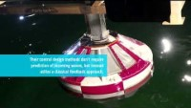
Wave Energy Converters and Controls

Slide 23
Damping
To increase the amount of power generated by the WEC we dampen its response to waves.
Damping causes the WEC to resist its upward movement
The more we damp the WECs response the more power we can create
But be careful! If we damp the WEC too much it can stop moving all together

Slide 24
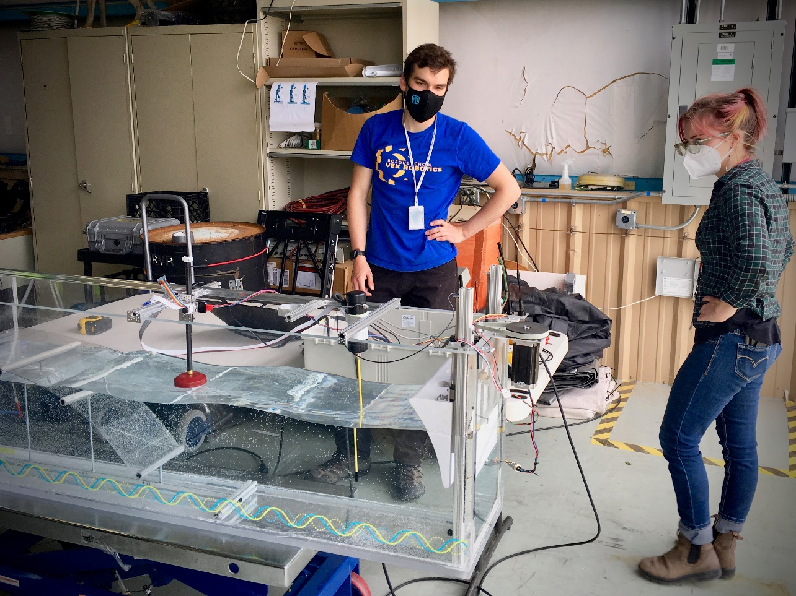
SIWEED Demonstration
The SIWEED demonstration allows you to change the dimensions of the waves as well as the controls of the Wave Energy Converter.
Try and optimize the amount of power so you can power all 4 quadrants of the town!

Slide 25
About the Sandia Blue Templates
Want more?
Browse additional design templates at creative.sandia.gov
Create impactful presentations, reports, and visuals with Sandia branded PowerPoint templates.
FEATURES
16:9 HD widescreen format
Embedded Sandia font & colors
Professional photo and text layouts available in the Sample Layouts deck
Access fully editable charts, maps, and icons in the PowerPoint Graphics Library
Easy to use placeholders crop photos without distortion Note: To reduce file sizes, templates do not include Images. UUR photos can be accessed at Sandia’s Flickr page.
Before submitting to Sandia Review and Approval, ensure only the appropriate markings are applied to content slides and Slide Masters.
Questions? Get immediate support from Creative Services. NM: (505) 844-7167 | CA: (925) 294-1010 | creative.sandia.gov
Revised 06.18.21

